Slide 1

Phishing Awareness Training
Learn to identify and protect yourself from phishing attacks. This training will equip you with essential knowledge and practical tips to stay safe online.

Slide 2
Understanding Phishing Attacks
Email Deception
Fake Websites
Phishing involves deceptive emails. They trick you into revealing sensitive information. Attackers impersonate trusted entities.
These emails often link to fake websites. They mimic legitimate sites. Their goal is to steal your credentials.

Slide 3

Recognizing Phishing Attempts
1
Suspicious Sender
Check the sender's email address. It often has slight misspellings or unusual domains.
2
Urgent Language
Phishing emails often create false urgency. They pressure you to act immediately.
3
Generic Greetings
Beware of "Dear Customer" greetings. Legitimate companies usually use your name.
4
Unusual Attachments
Never open unexpected attachments. They often contain malware.

Slide 4

Social Engineering Tactics
Pretexting
Baiting
Attackers create a believable fabricated scenario. They manipulate you into divulging information.
Offering something enticing like free downloads. This lures victims into a trap.
Quid Pro Quo
Promising a service in exchange for information. It often involves technical support scams.

Slide 5
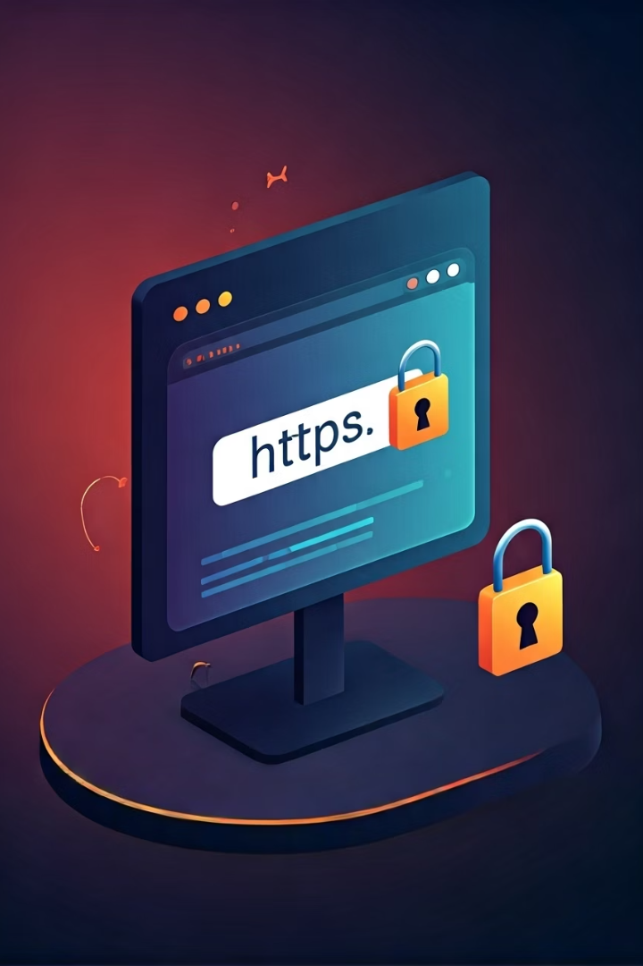




Identifying Fake Websites
HTTPS & Padlock
Check URL
Poor Quality
Always look for "https://" and a padlock icon. This indicates a secure connection.
Inspect the URL carefully. Misspellings or extra characters are red flags.
Fake sites often have low-quality images or typos. These indicate a fraudulent site.
Too Many Questions
Be wary if a site asks for excessive personal data. Legitimate sites rarely do.

Slide 6





Best Practices for Protection
Verify Sender
Always double-check the sender. Call them directly if unsure.
Strong Passwords
Use unique, complex passwords. Enable two-factor authentication (2FA).
Keep Software Updated
Regularly update your operating system and applications. This patches vulnerabilities.
Report Suspicions
If you suspect a phishing attempt, report it immediately to IT security.

Slide 7
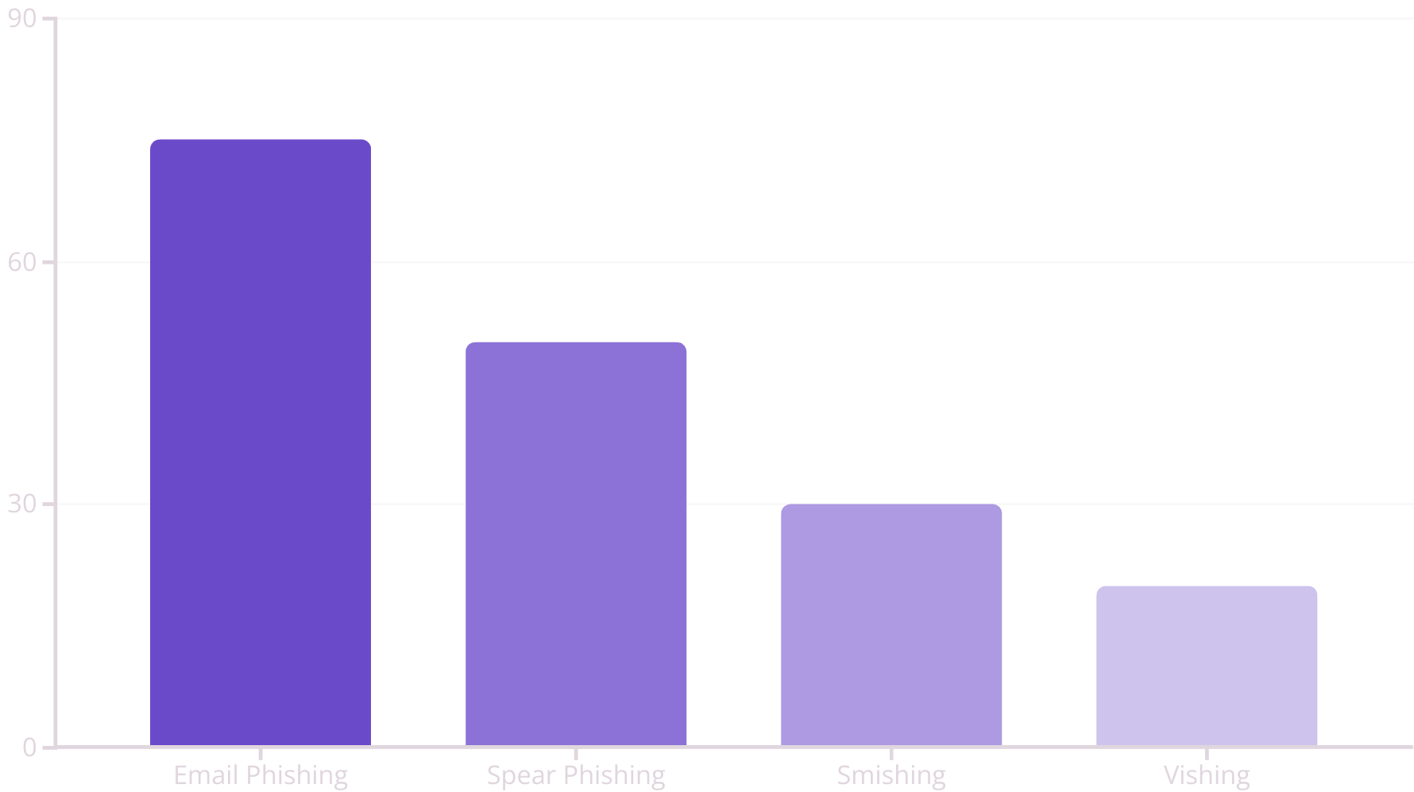
Real-World Examples
Phishing is a widespread threat. Email phishing remains the most common. Spear phishing targets specific individuals. Smishing and vishing use SMS and voice calls.

Slide 8

Key Takeaways & Next Steps
1
2
3
Stay Vigilant
Verify Sources
Report Suspicious Activity
Always question unexpected communications.
Confirm legitimacy before clicking links.
Your quick action protects everyone.
Remember these steps to enhance your security. Continue practicing good cyber hygiene. Report any suspicious activity to the IT department immediately. This helps protect our entire organization.

Slide 9
Test Your Phishing Knowledge
See how well you remember the important signs and safe practices.
Question 1: Which of these is a strong sign that an email might be a phishing attack?
It uses your full name.
It comes from a well-known company website (like @microsoft.com).
It asks you urgently to check your account details by clicking a link.
It includes a company logo.
Question 2: What should you do if you get an email with an attachment you didn't expect, even if it looks like it's from someone you know?
Open it right away to see what it is.
Email the sender back to ask about the attachment.
Send it to a friend for their thoughts.
Don't open it; instead, ask the sender about it using a different way (like a phone call).
Question 3: When you visit a website, what is a key sign that it's safe and secure?
The website loads quickly.
The address starts with "http://".
You see a padlock icon and "https://" in the web address bar.
The website looks very fancy.
Question 4: In social engineering, what does 'Pretexting' mean?
Giving you a free download if you give them your personal information.
Making up a fake story to trick someone into giving away information.
Sending a text message with a bad link.
Calling someone and pretending to be tech support.

Slide 10

Thank You!
We appreciate your attention and commitment to strengthening our collective security against phishing threats. Your vigilance is our best defense.
If you have any further questions or concerns, please do not hesitate to contact the IT security department.
Notes:
This slide serves as a concluding thank you, reinforcing the importance of the training and encouraging ongoing vigilance. Acknowledge participation. Reiterate commitment to security. Provide a clear call to action for further support.

